Slide 1

Arizona Water Availability Analysis
100 Year Plan
Robin Stewart
Data Scientist

Slide 2
Arizona Water Summary
Sources and USES of WATER.
Arizona existing water plan.
When does Arizona run out of water

Slide 3
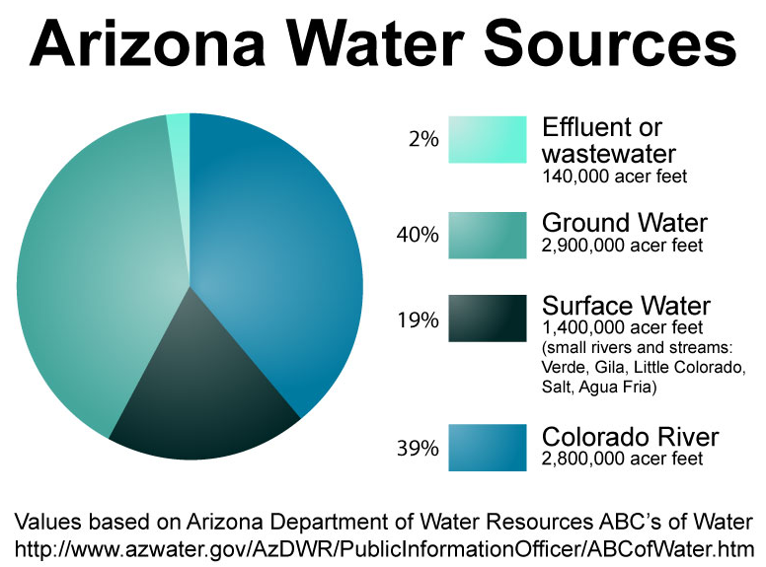
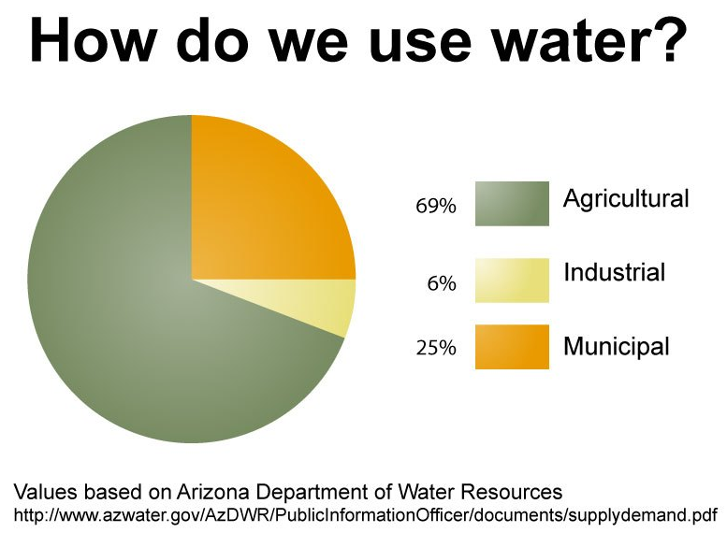
Sources & Uses of Water
Arizona uses over 7 million acre-feet of water in a year. 1 acre-foot = 325,851 gallons

Slide 4
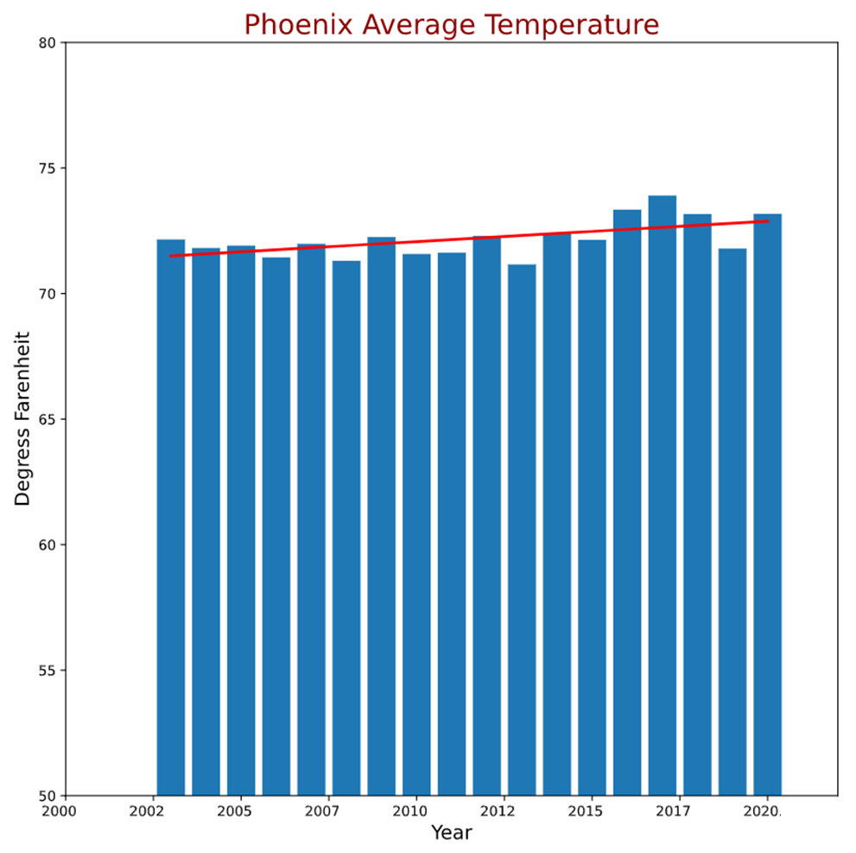
Climate
Hot and getting hotter
Rain is scarce

Slide 5
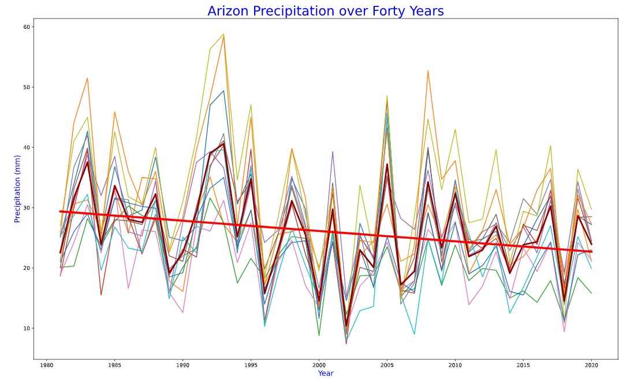

Slide 6
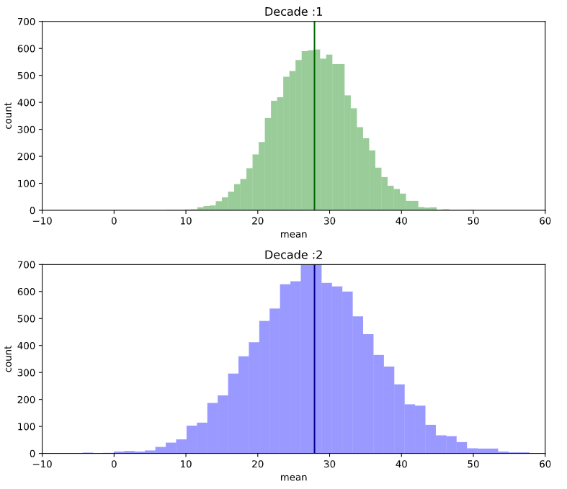
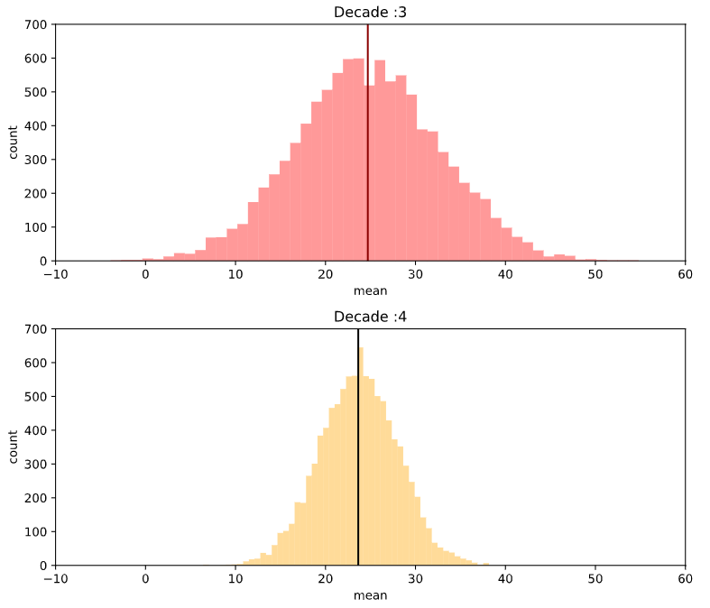
Precipitation Analysis
1 Decade to Last Decade p-value: 0.08699582881507466
2 Decade to Last Decade p-value: 0.19416225315164418
3 Decade to Last Decade p-value: 0.7313857541194515

Slide 7
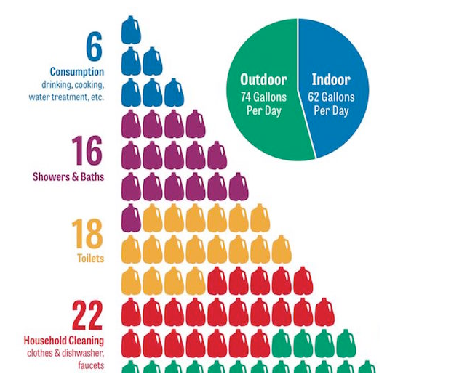
How much water do people use?
33% of Arizona households have pools – highest per capita pool ownership in US
Medium-sized hotel pool loses 1500 gallons a day to evaporation
Average home pool loses 2000 gallons / month
Phoenix has one of the highest water usages in US
Data source: statista.com

Slide 8
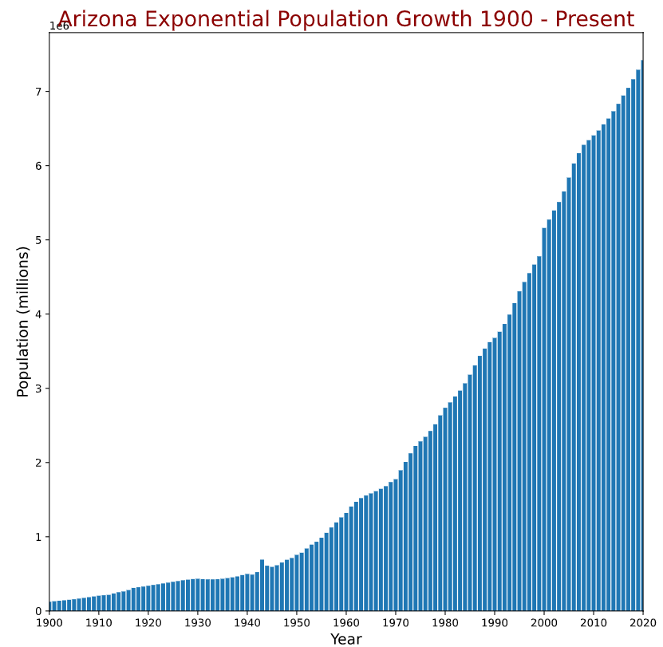
Arizona Population
Seven million in AZ
Five million in Greater Phoenix
Growing between 1.5 – 1.8% each year
Data source: macrostrends.net

Slide 9
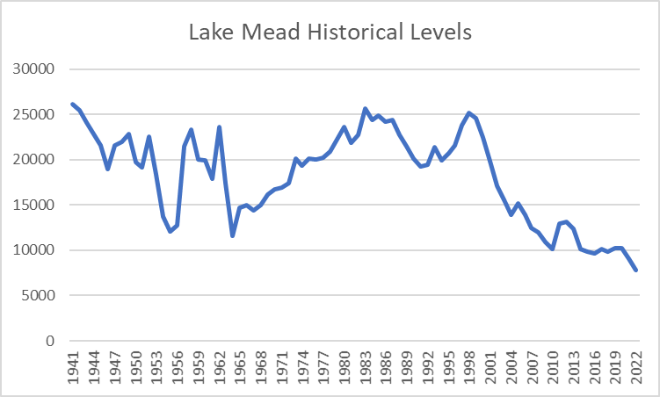
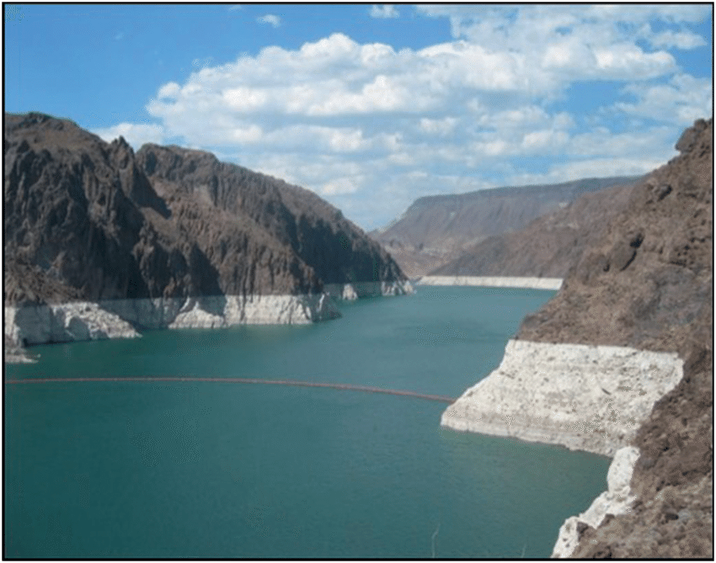
Colorado River – Lake Mead
End-of-water-year (Sept. 30) storage in Lake Mead and Lake Powell, in thousands of acre feet, Source: USBR

Slide 10
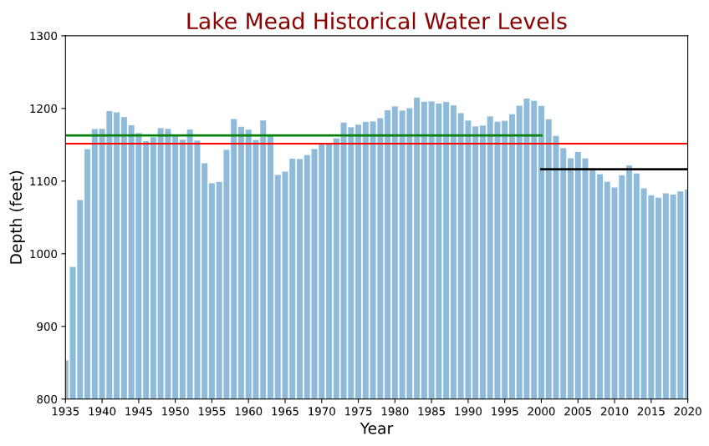
Lake Mead Historical Water Levels
- red line depicts mean for entire timespan
- green line depicts mean until 2000
- black line depicts mean for past twenty years (mega drought)

Slide 11
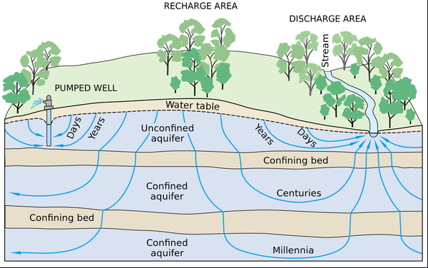
Arizona Impact of Curtailment
-Reduction of 933,333 acre-feet of water
-Deficit will come from aquifer
-How much water do we actually have?

Slide 12
Aquifer Assessment
 | Water Level Chg | Wells Decreasing | Well Count | w/o Phoenix AMA
20-year | 3769 | 58% | 1245 | -5459 | 67% | 607
10-year | -2735 | 62% | 1024 | -4057 | 67% | 797
1-year | -495 | 58% | 1235 | -537 | 60% | 969
- 58% of wells declined but the 20-year assessment showed an increase that was statistically significant…why?
- Both 10 yr and 1 yr comparisons showed a statistically significant decline in water levels
 | All Wells |  | w/o Phoenix
 | t | p | t | p
20-year | 0.4698 | 0.6385 | -0.8862 | 0.3757
10-year | -0.3339 | 0.7385 | -0.5515 | 0.5813
1-year | -0.0528 | 0.9579 | -0.0628 | 0.9500

Slide 13
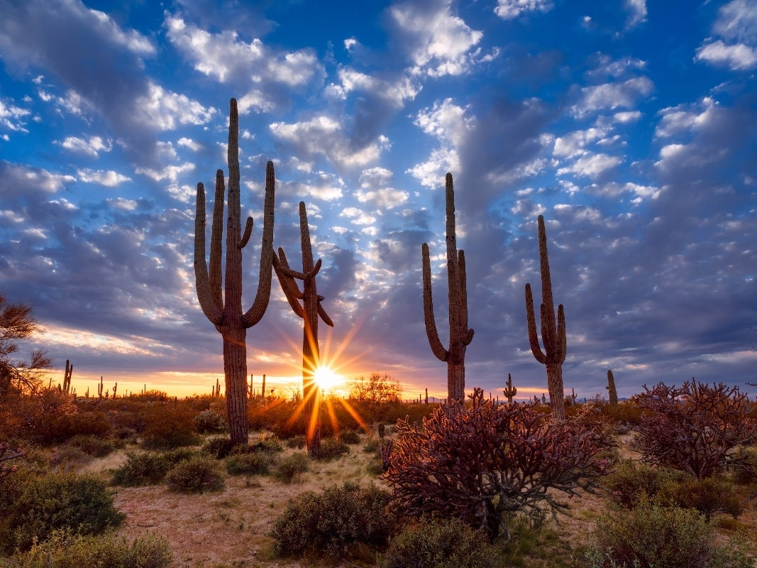
Key Findings
Arizona’s 100-year water plan Groundwater Management Act (GMA) designed to protect groundwater resources enacted in 1980
Hundreds of private wells are unmetered and unregulated
CAP has 100-year obligation (contracts) to replenish ground-water
The data clearly shows that Arizona is not meeting its recharging goals for the past ten years
In 1980, climate change was not a reality, the Colorado River source was dependable

